Slide 1

Teams Most at Risk by phishing?
HR
Marketting
These teams often deal with sensitive information and may be targeted for access to financial or client data.

Slide 2

What is Phishing?
Phishing is a form of cyber attack where attackers impersonate legitimate entities to trick individuals into revealing sensitive information such as passwords, financial details, or personal data.

Slide 3
Learning to Spot Phishing Emails
Legitimate emails | Phishing emails
Sender's email is recognizable or official domain | Sender's email may look familiar but with misspelled domain
Subject is clear and relevant | Subject creates urgency ('Account Security Alert')
Content is professional and straightforward | Content may contain grammatical errors or unusual requests
Now, let's talk about recognizing phishing emails.
On the screen, you'll see two sets of emails side by side—one legitimate, one phishing.

Slide 4

How Do We Stop Getting Phished?
Verify sender identity.
Think before clicking.
Be wary of urgency.
Keep software updated.
Report suspicious activity.

Slide 5
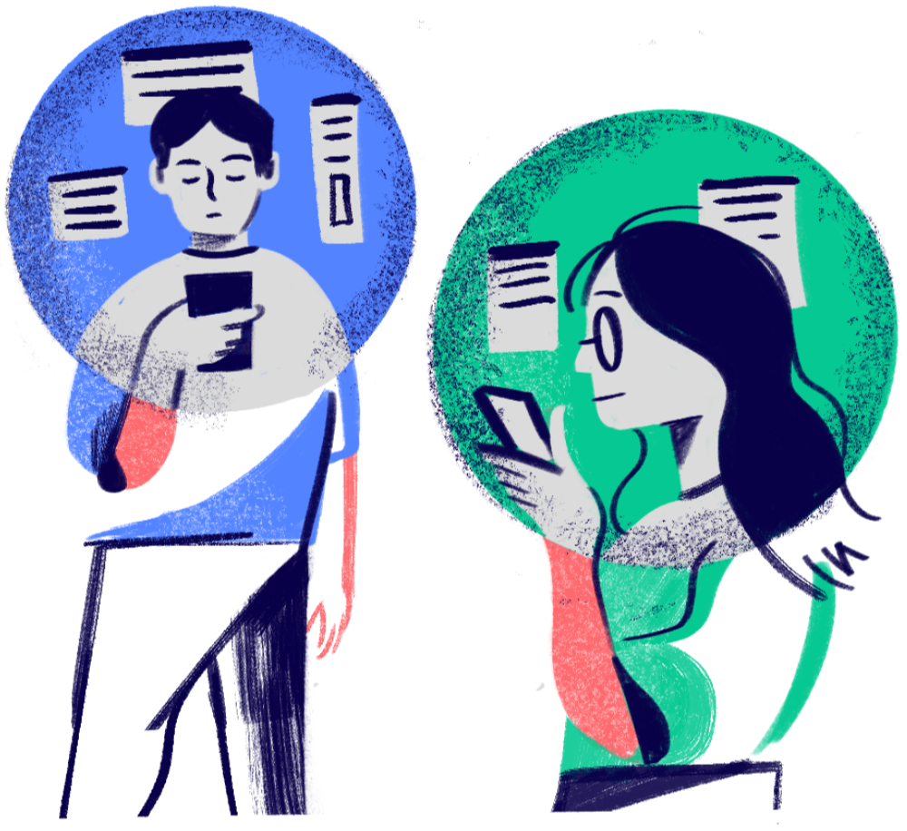
Thank you very much!

